Slide 1
Industrial Process Modeling
A Model-Based Approach to Industrial Cybersecurity, Risk Assessment and Quality Control
Lawrence A. Waller
Project Mentor: Jules White
Tuesday, December 1st, 2015

Slide 2
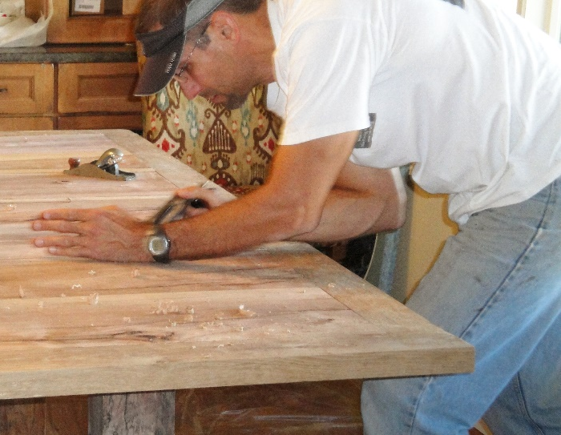
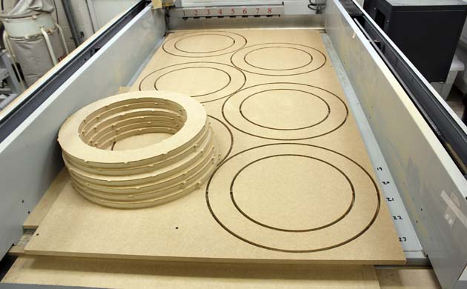
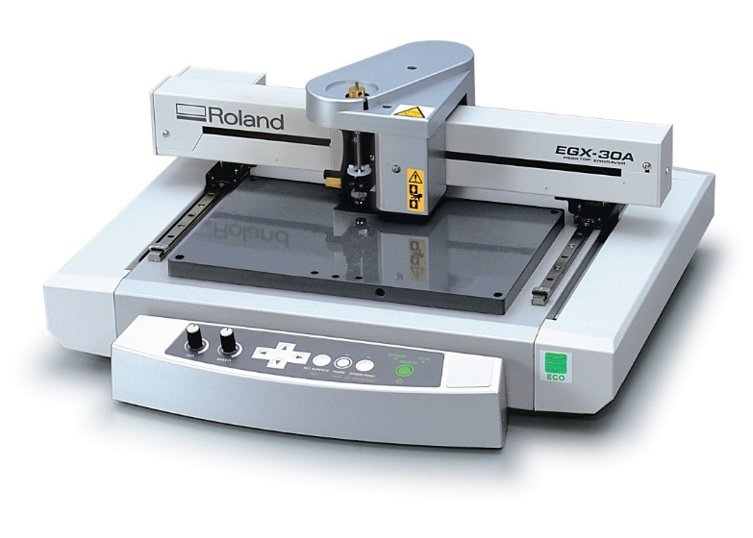

Manufacturing processes are increasingly automated…
One-off carpentry by hand
CNC Wood Slicing
AutoCAD-controlled Engraving Printer
Metal Engraving

Slide 3
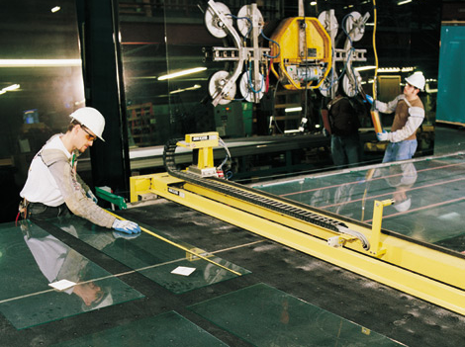





Imagine a scenario in the near future…
CNC controlled Glass Scoring Machine, creating Aircraft glass
He finds a bad patch to Windows 2000, then searches for companies still using it.
CNC Glass Cutting Software, only compatible with Windows 2000.
Glass Scoring is set too shallow, creates microfractures in the glass.
A cyberterrorist downloads the NIST vulnerabilities database.
Depressurization at high altitudes shatters multiple windows, causing an aircraft to crash.

Slide 4
Project Goals
Working with Dr. White, my primary goal was to create a metamodel, model, and interpreter for industrial processes.
The interpreter provides a 5-step validation schema for identifying potential industrial problems (inexperienced employee, vulnerable software, mismatched materials, etc.)
In order to achieve this goal, I had to study a lot of material science in order to understand how cyberterrorists could sabotage industrial production.

Slide 5
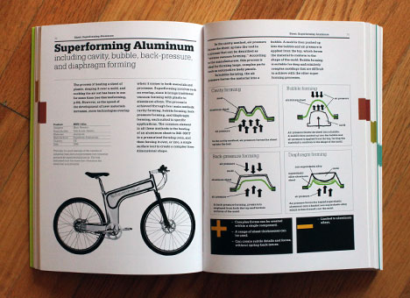
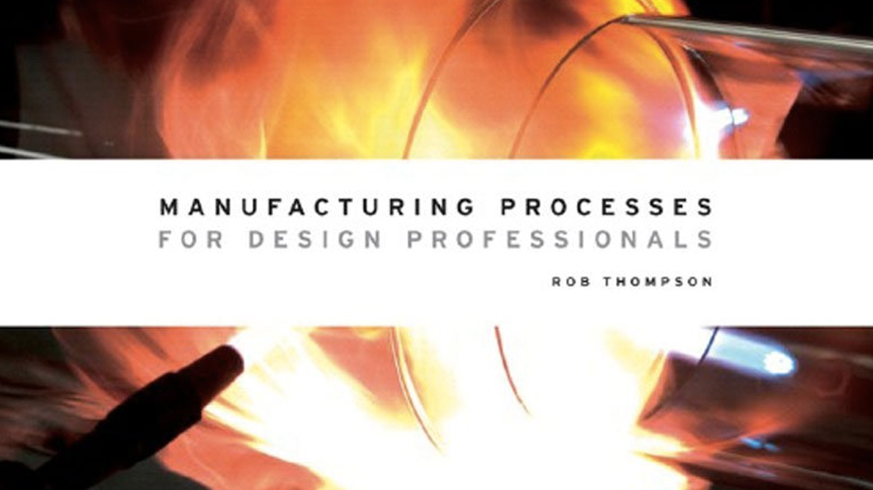
Step 1: Understand the Subject Matter
“What is an Electron Beam Welder? I didn’t take Materials Science!”
Chris Lefteri
Making it: Manufacturing Techniques for Product Design, 2nd Edition.

Slide 6
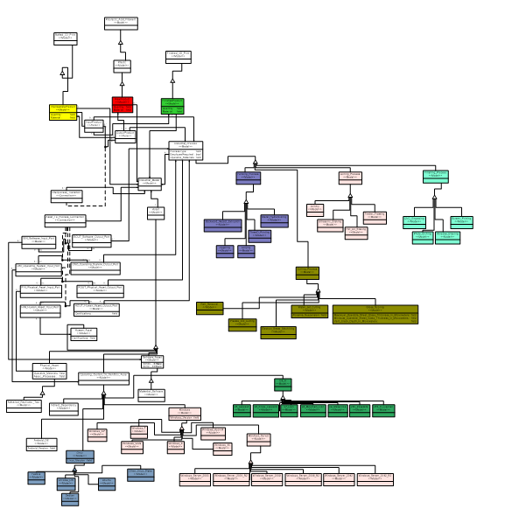
Step 2: Create a Metamodel
Products
Raw, Intermediate, Complete
Processes
Forming, Cutting, Joining, Finishing
Assets
Physical, Human, Software, Sandbox
Encompassing Model
Industrial “Factory” as base model type, can contain countless processes
Connections
Connecting Processes, Products, and Assets within a Factory

Slide 7
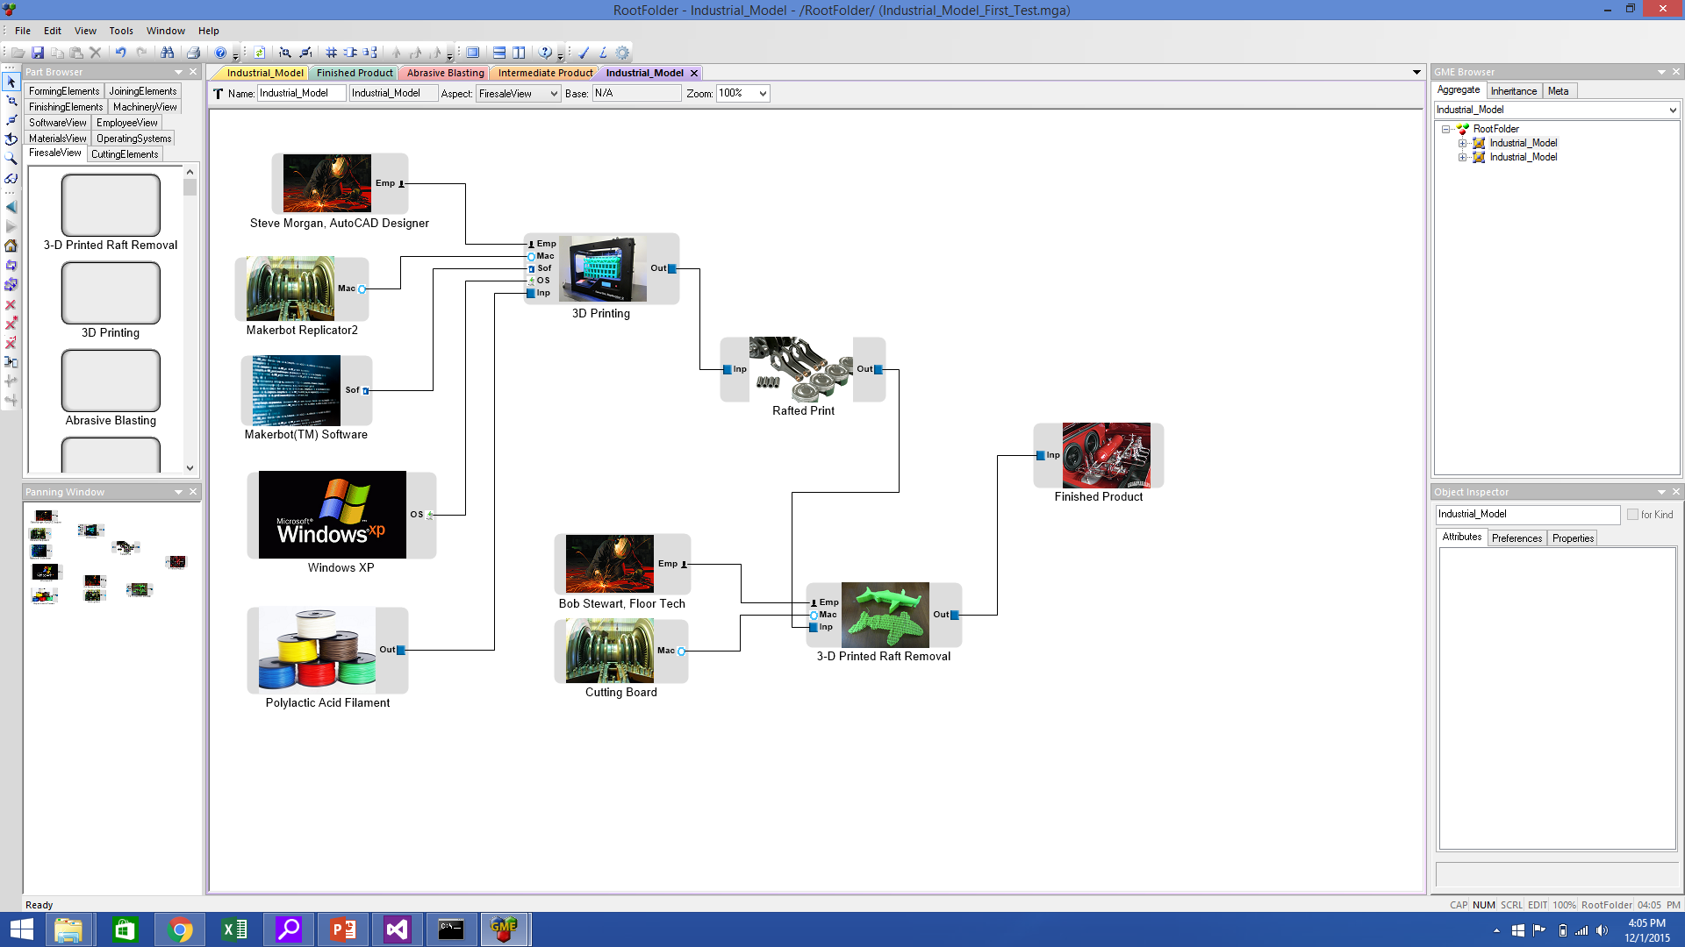
Step 3: Create and experiment with Models (Also modify Metamodel to address functionality problems)

Slide 8

Step 4: Write an interpreter to provide validation and functionality.
Hardware Validation of Model
Software Validation of Model
Human Resources Validation of Model
Thematic Analysis
NIST Vulnerability Analysis and Suggested Employment of Cyberterror Countermeasures

Slide 9
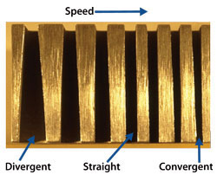
Process Validation: Thematic Validation
Is a process being employed according to the model’s material validation laws?
An operable materials attribute specifies which input materials a process can operate over.
Does a better process exist to execute that task?
An algorithm can also be tied in to help evaluate which processes might be more effective. For example, one can use a water jet cutter or a plasma cutter to cut titanium, but thicker titanium sheets are harder to cut with the water jet—there is a speed vs accuracy tradeoff.
Water jet cutting can become inaccurate, leading to an undesirable taper. Use a plasma cutter instead.

Slide 10
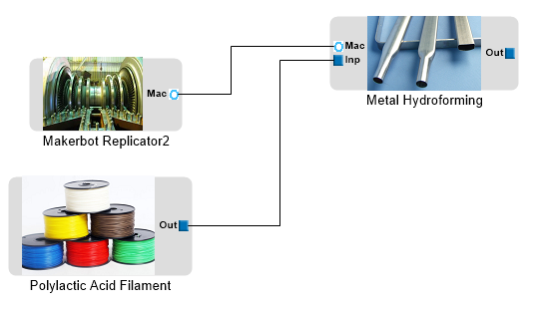
Process Validation: Hardware Validation
Are all machines assigned to processes for which they were designed?
Throw an error if, for example, a 3D Printer is assigned to a glassblowing process.
Are machines operating within material input constraints?
Throw an error if a spot welder is assigned plastic or glass parts to join.
This model would register as invalid because the Makerbot Replicator2 physical asset cannot be assigned to the “Metal Hydroforming” process

Slide 11
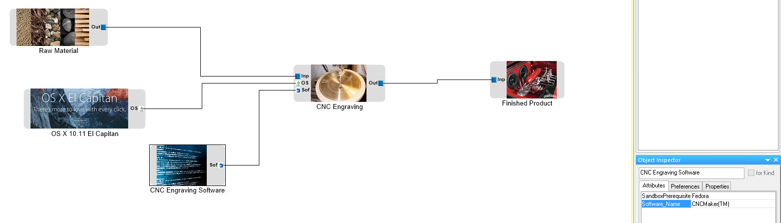
Process Validation: Software Validation
What software is necessary for an industrial process?
Throw an error if the company does not own all of the right software.
What are the sandbox requirements of that software?
Throw an error if sandbox software is incompatible with proprietary process software. For example, if a particular CNC plywood cutting software only runs on Windows XP, but a company’s computers are all set up for Fedora.
This model will be caught as invalid because the CNC Engraving Software requires the Fedora Operating System, but the model places it in an OS X sandbox environment.

Slide 12
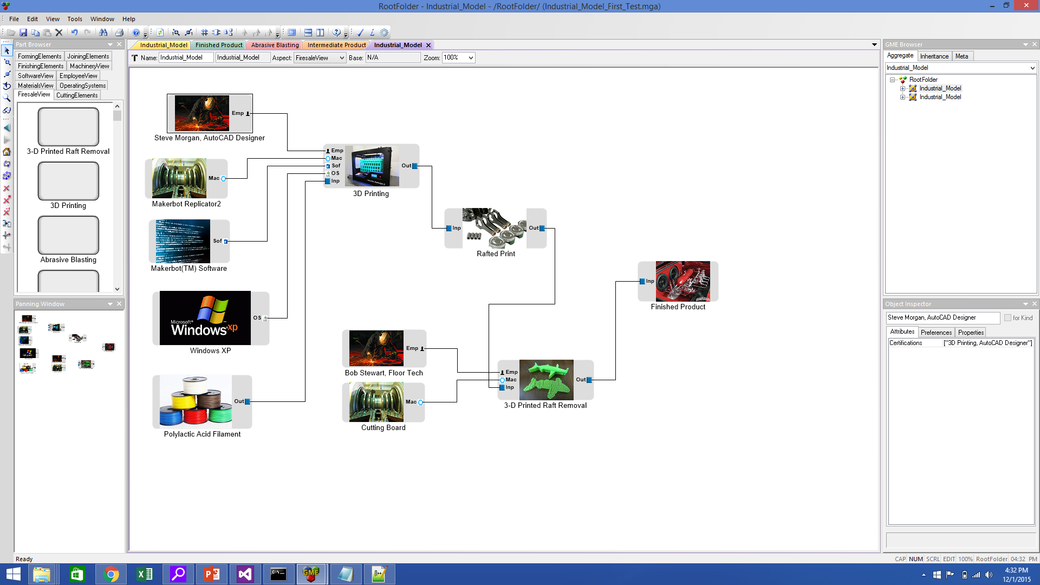
Process Validation: Human Resources
Certification
Is a particular employee certified for the process to which he is assigned?
Roles
Example: Two employees collaborate on a 3-D printing process
One designs the print, the other cuts it out after it is rafted.
Within that process, is an employee certified to fill a specific role?
This is valid!

Slide 13
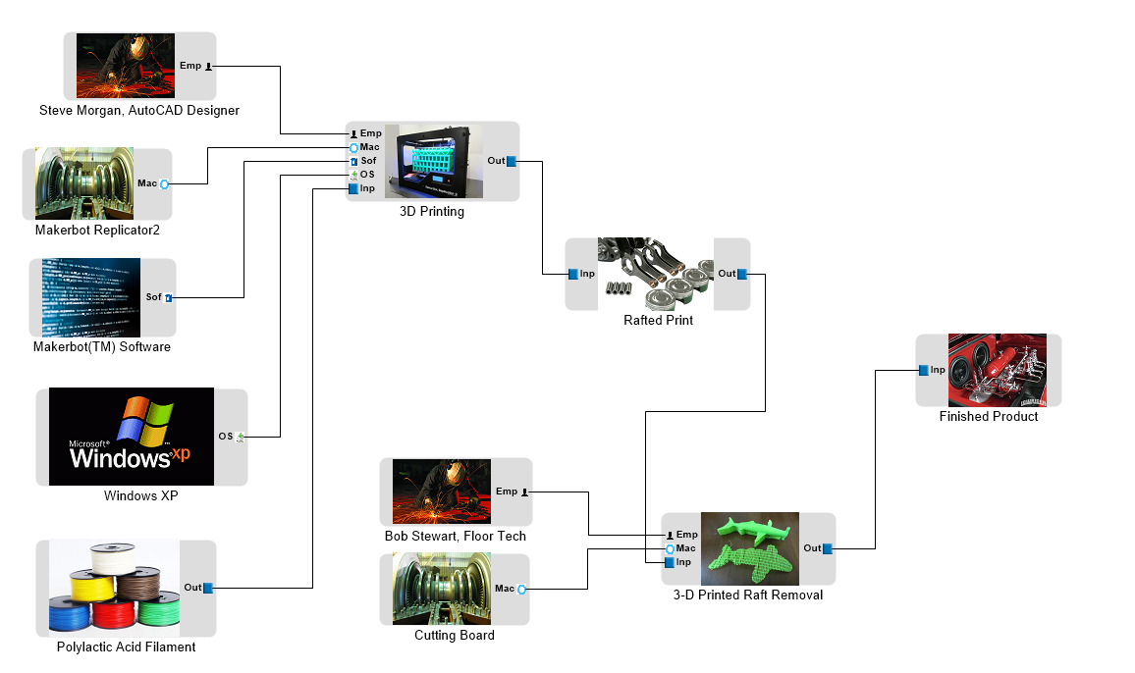
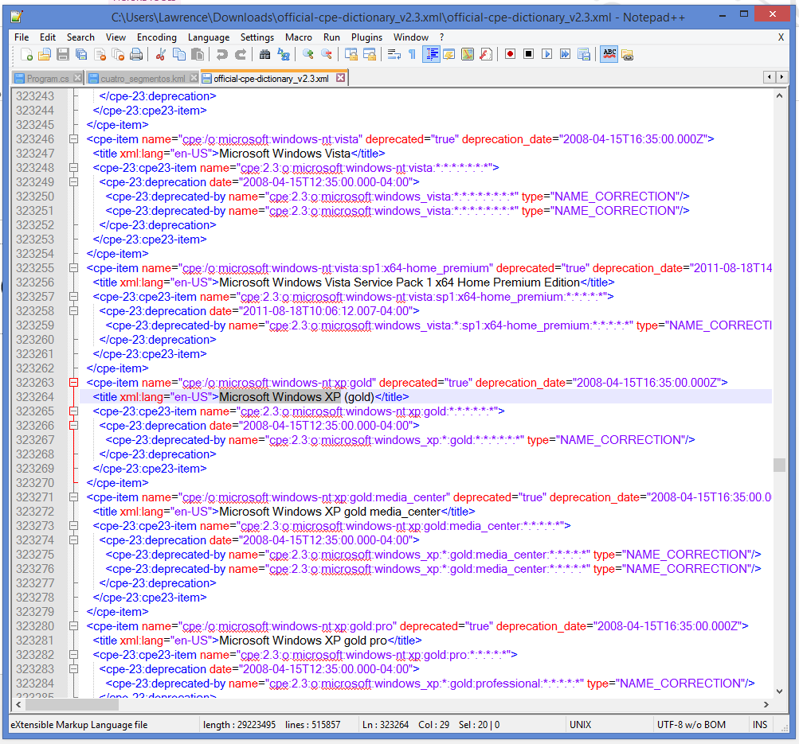
NIST Vulnerability Detected, Quality Control Required
Due to the vulnerability of Windows XP as employed by Makerbot’s software, all products coming out of the 3D printing process are suspect.
Possible solutions: Iterate through the “Possible Critical Failures” array and test products by hand before proceeding to the next process. Replace Windows XP with a better OS, if possible.

